Slide 1
Optimizing RIDE Sharing allocation
Analysis on Ridership Allocation for Transportation Network Providers
Presented by:
Duo zhou, Amily huang, bowen zhao, Yiheng Zhu

Slide 2
Analysis on Ridership Allocation for TNPs
Presented by:
Duo zhou, Amily huang, bowen zhao, Yiheng Zhu

Slide 3
Executive Summary
Our goal is to optimize vehicle allocation according to ridership demand and give business insights and recommendations to TNP companies.
We are going to use data regarding weather, major events, public safety, and income level to analyze user behavior and to give precise recommendations.
We will create a relational database system that can efficiently load, store, and extract data from different sources for analysis.
Notes:
which is essential to the success of Transportation Network Providers (TNP) (Rideshare Companies)
Ridership demand can be greatly affected by, and many other factors.

Slide 4
Business Use Case
Actor | Incentive | Business Use
TNP | Understand customer behavior better Optimize vehicle allocation Improve customer service management | Understand how different factors impact ridership frequency
Driver | Maximize income per unit time | Understand how fare and tips vary in different circumstances
Customer | Time-efficient and safer service | Satisfy customer experience with better vehicle allocation and customer service
Notes:
TNP can utilize our analysis to optimize their vehicle allocation system according to various factors.
TNP can use our analysis to better understand customer behavior based on various factors.
Drivers can use our analysis to find locations where ridership demand is high and customers tip very generously.
TNP can further increase the maximum wait time for locations that have high crime rate. Which can greatly benefit customers

Slide 5





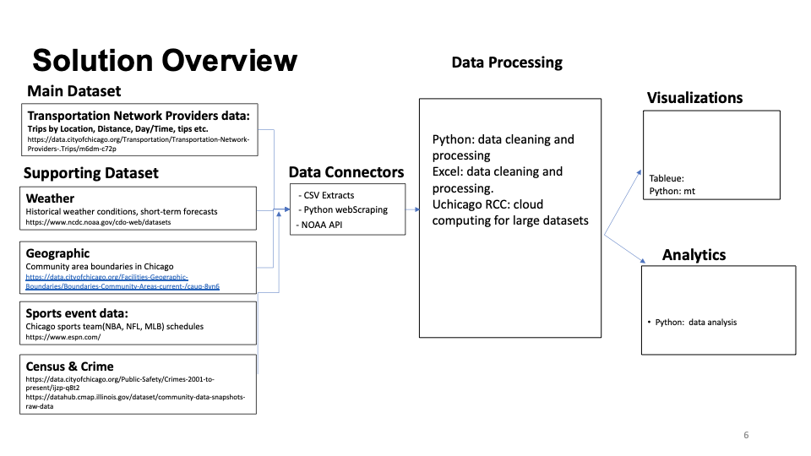
Solution overview: Data / Tools
Main dataset:
Data Processing:
Visualizations:
Transportation Network Providers – Trips by Location, Distance, Day/Time, Tips, etc.
https://data.cityofchicago.org/Transportation/Transportation-Network-Providers-Trips/m6dm-c72p
Python: data cleaning and processing
Excel: data cleaning and processing
Uchicago RCC: cloud computing for large datasets
Tablaue
Python: Matplotlib/ Seaborn/ggplot/Bokeh/Plotly
Data Connectors:
Supporting dataset:
Weather
– Historical Weather Conditions, Short-term Forecasts
https://www.ncdc.noaa.gov/cdo-web/datasets
CSV Extracts
Python: WebScraping
NoAA: API
Geography
– Community area boundaries in Chicago
https://data.cityofchicago.org/Facilities-Geographic-Boundaries/Boundaries-Community-Areas-current-/cauq-8yn6
Sports Event
– Chicago sports team (NBA,NFL,MLB) schedules
https://www.espn.com
Analytics:
Census & Crime
https://datahub.cmap.illinois.gov/dataset/community-data-snapshots-raw-data
https://data.cityofchicago.org/Public-Safety/Crimes-2001-to-present/ijzp-q8t2
Python:
Data Analysis

Slide 6
Data Processing
Python: data cleaning and processing
Excel: data cleaning and processing
Uchicago RCC: cloud computing for large datasets
Visualizations
Tableue:
Python: Matplotlib/ Seaborn/ggplot/Bokeh/Plotly
AnalyticsPython: data analysis

